Slide 1
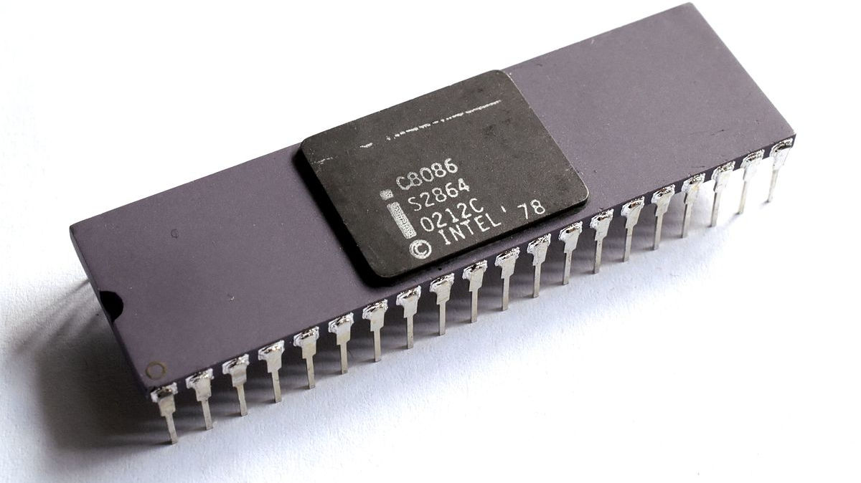
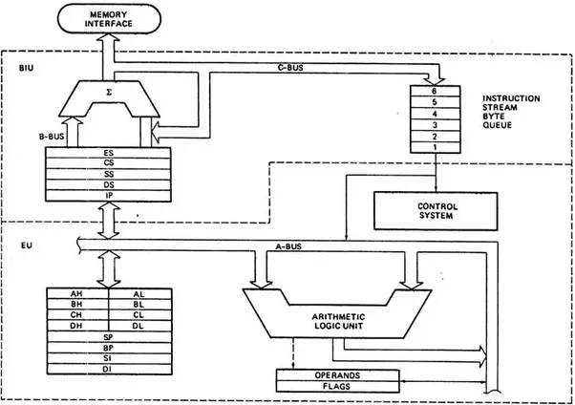
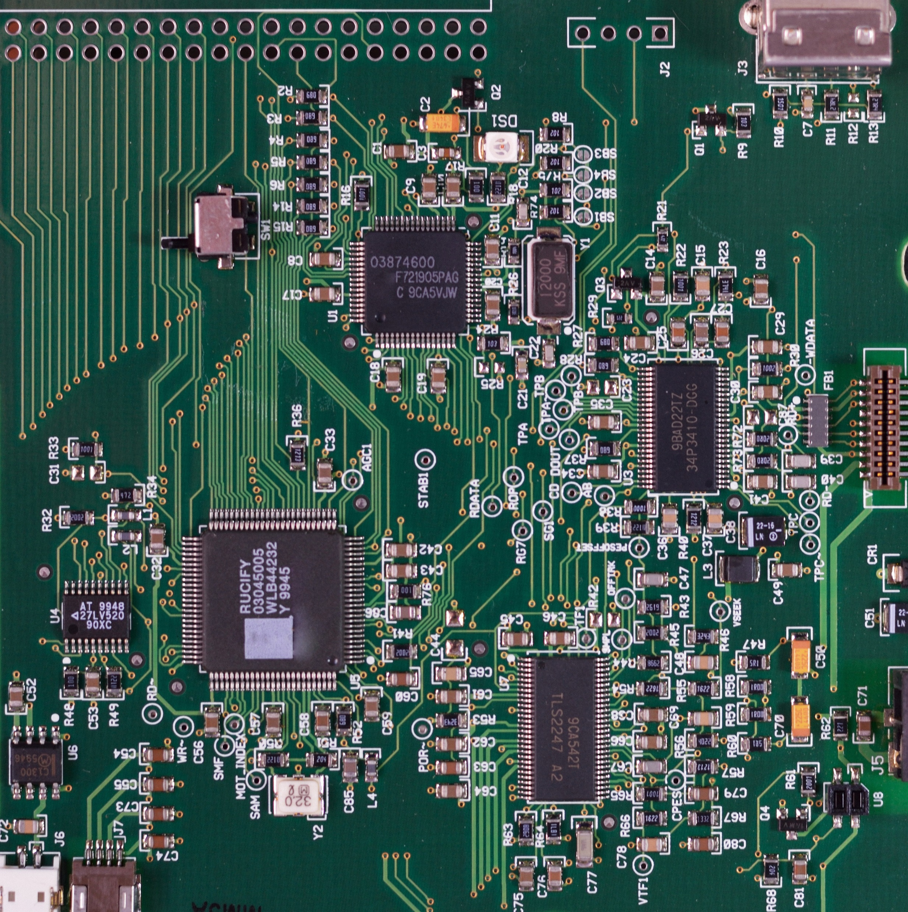
Third Project
16-bit CPU
Victor Moreno Arribas 180070
Jorge Albendea Pizarro 190229

Slide 2
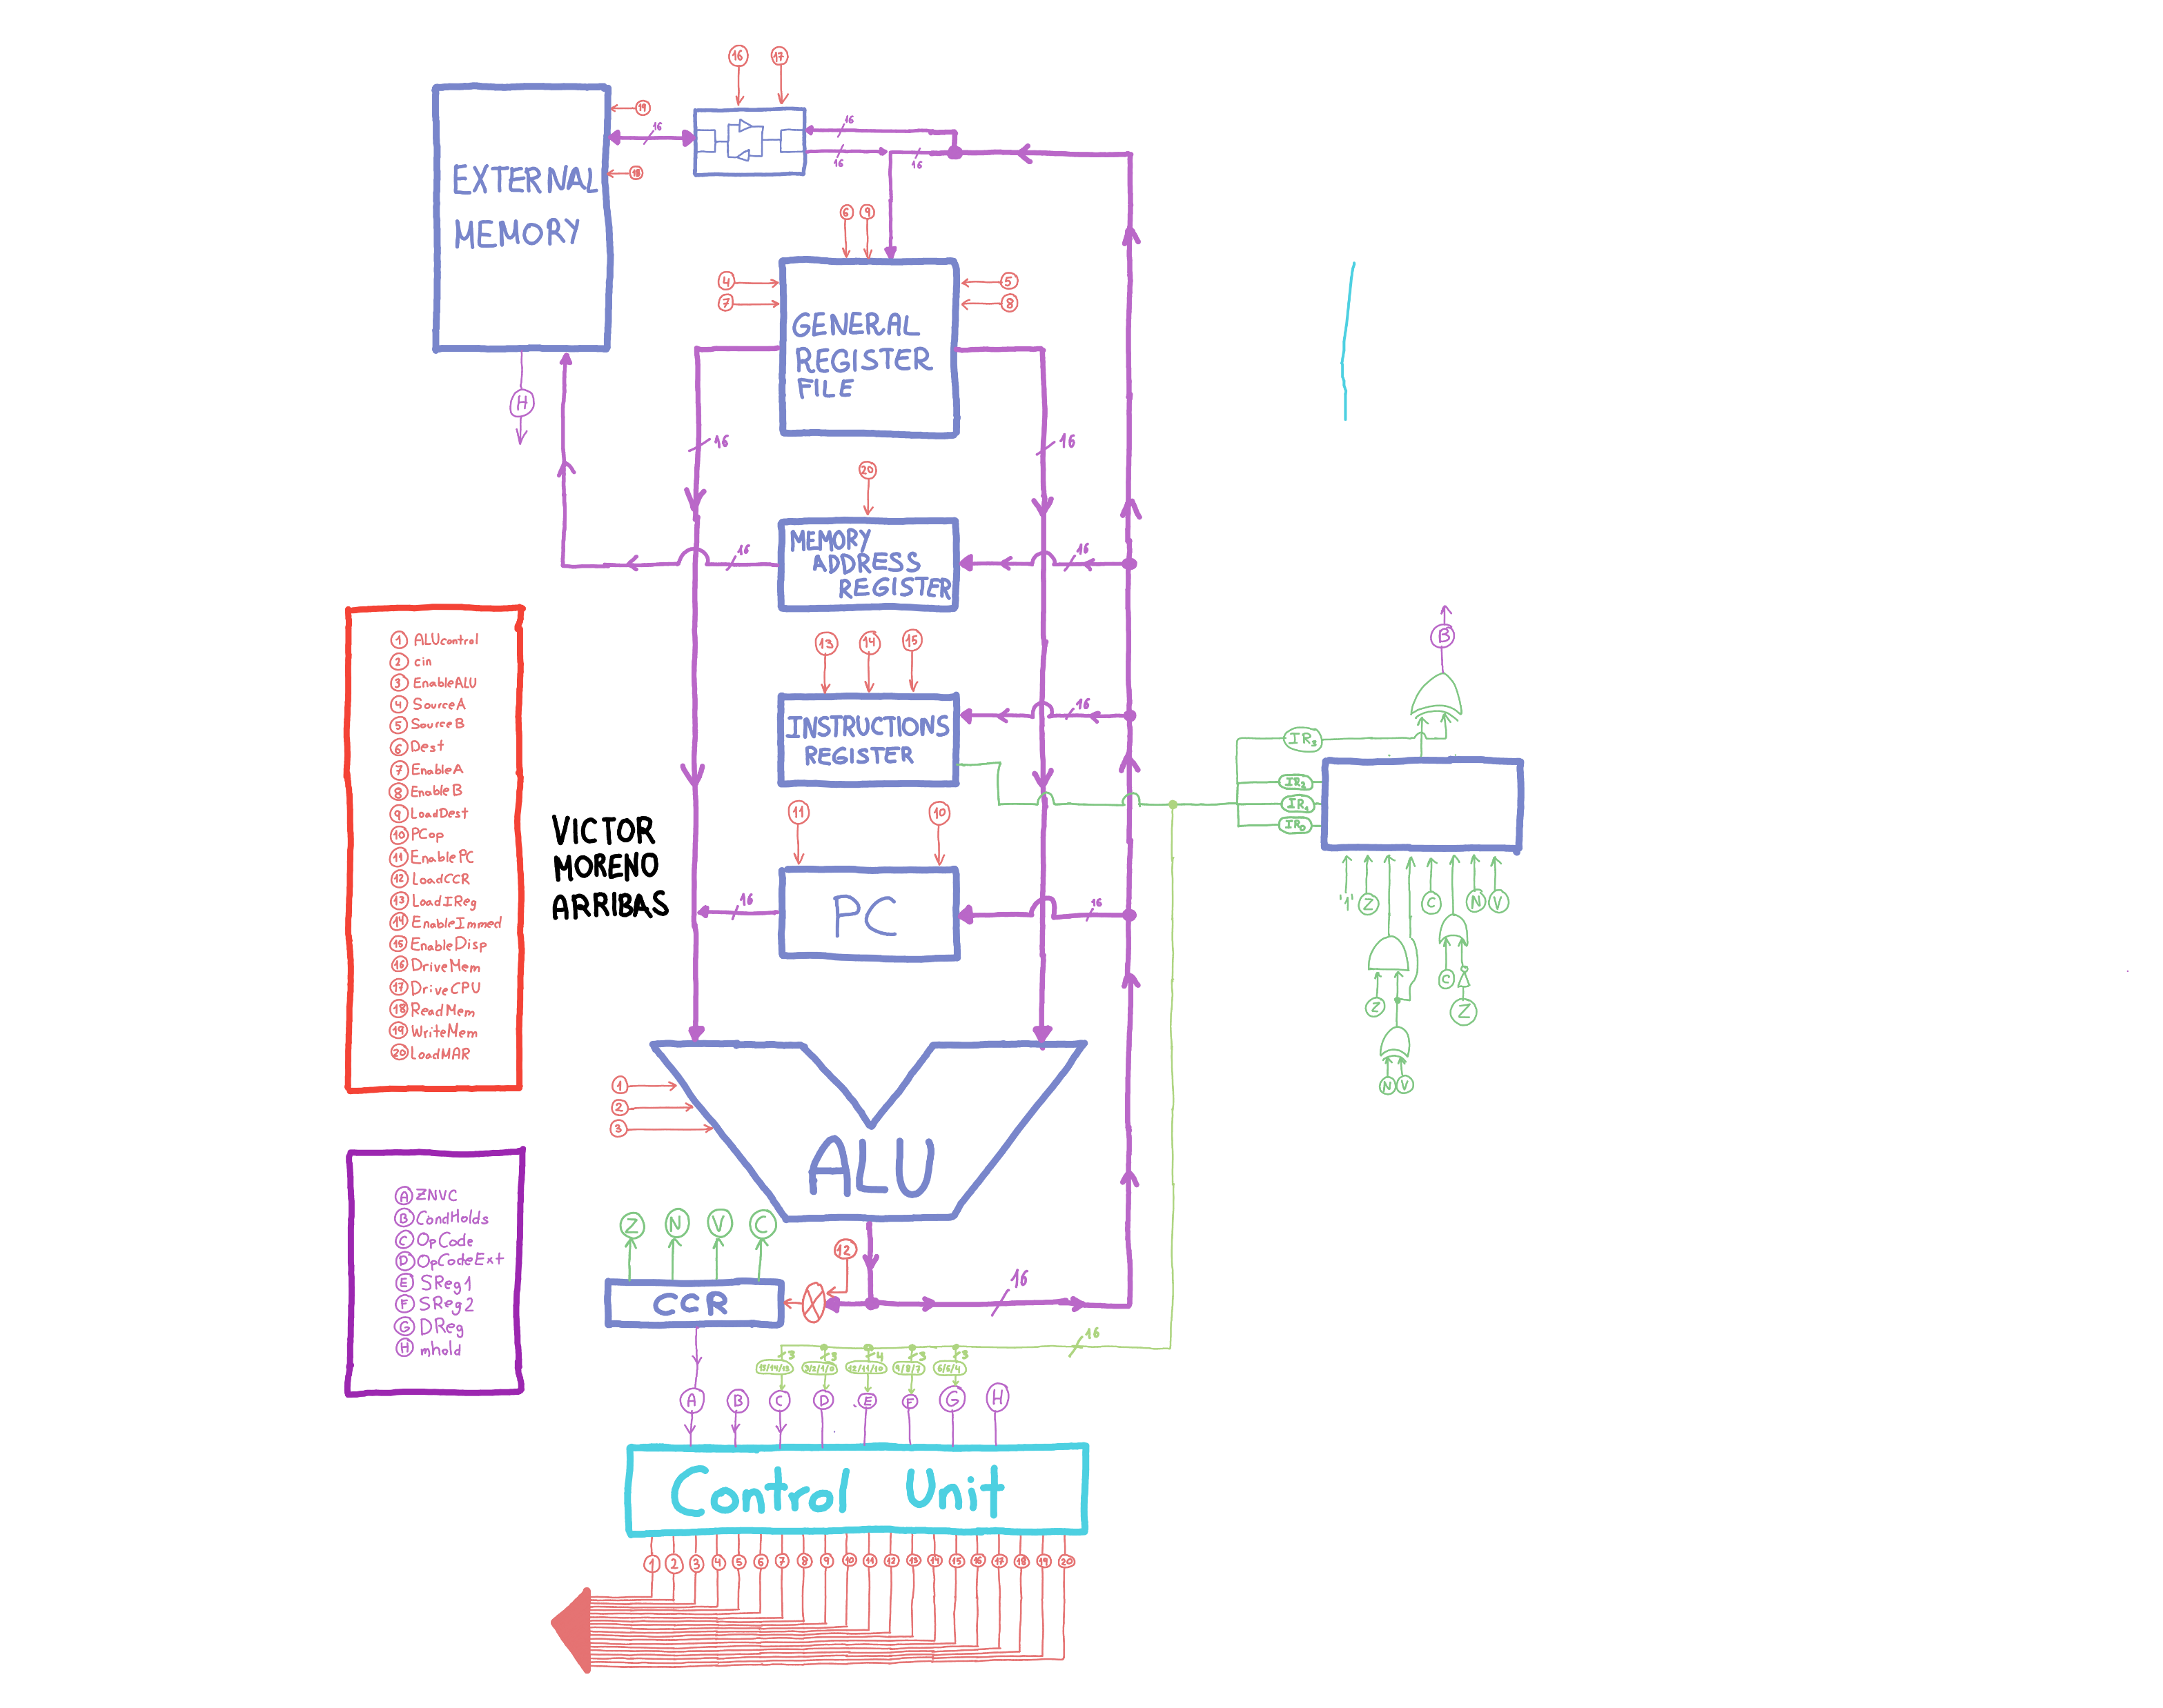
CPU signals
Question 1
States diagram
Question 2
States decoder

Slide 3
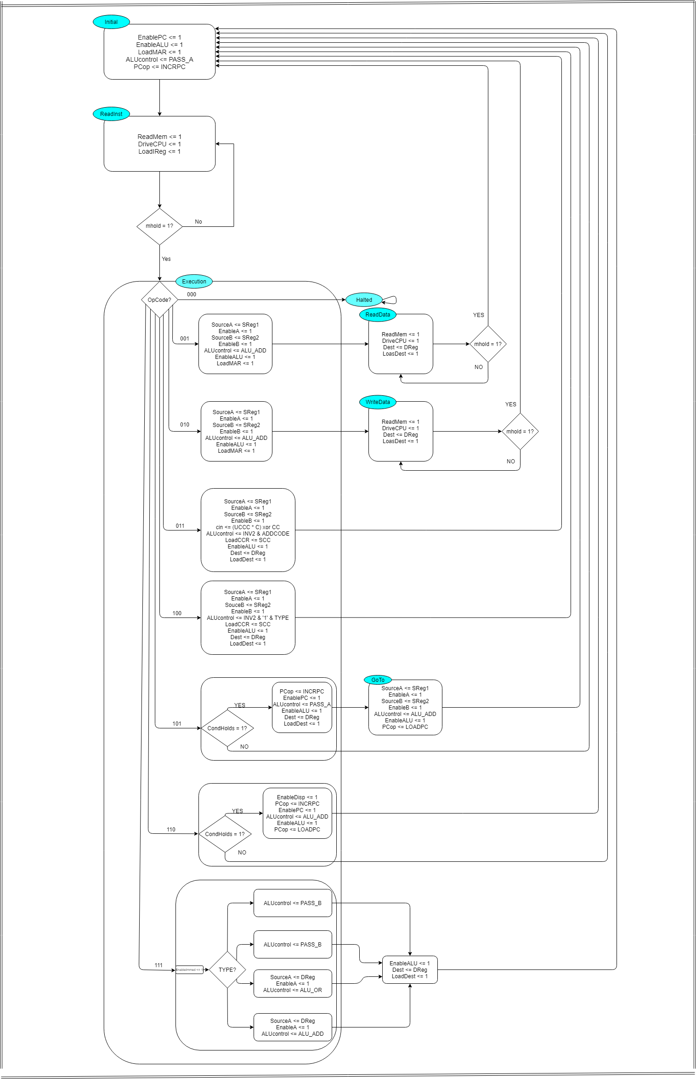
CPU signals
Question 1
States diagram
Question 2
States decoder

Slide 4
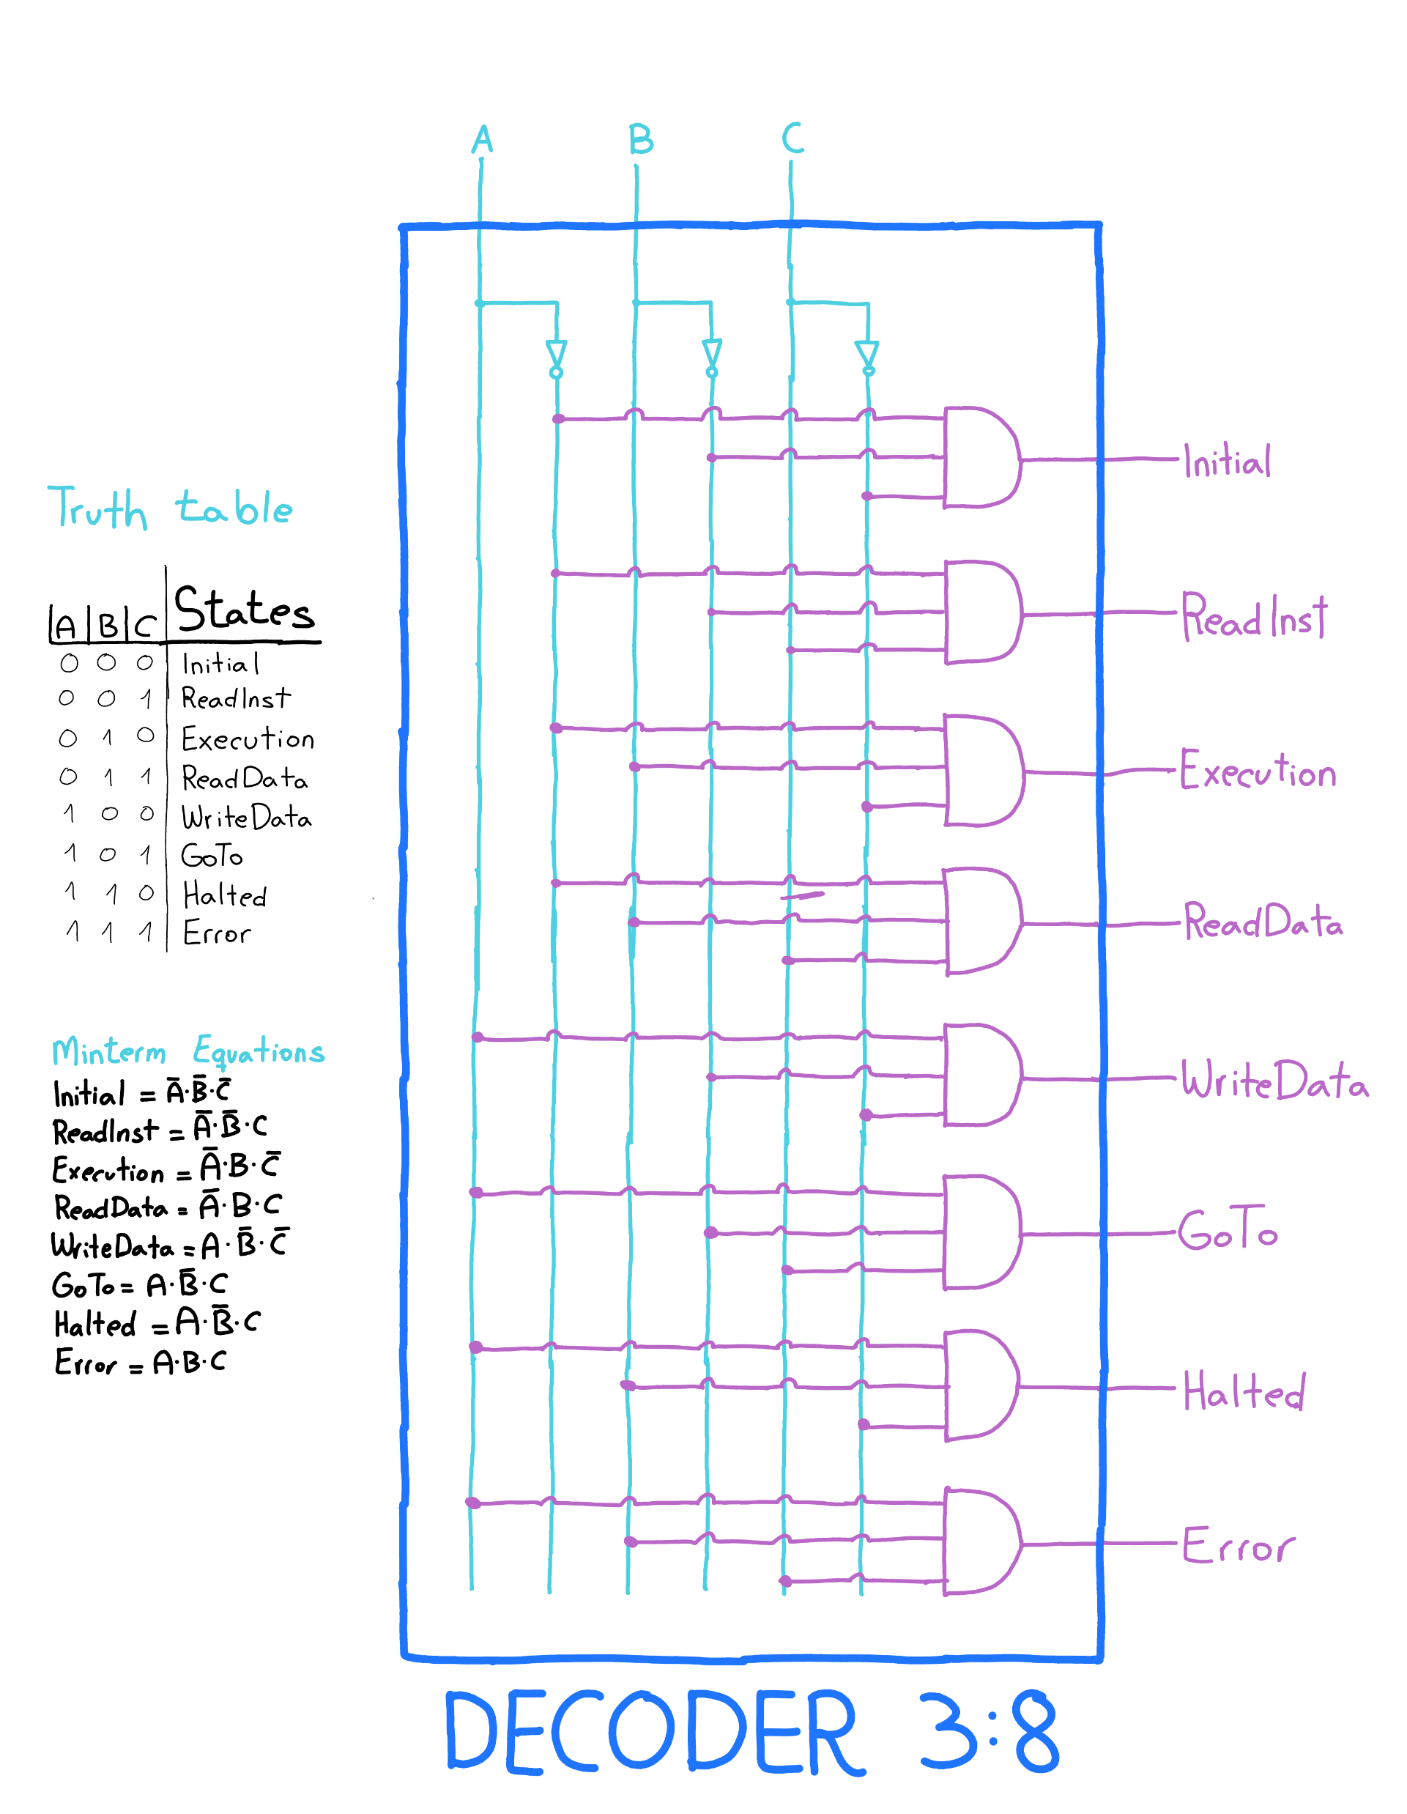
CPU signals
Question 1
States diagram
Question 2
States decoder

